Slide 1
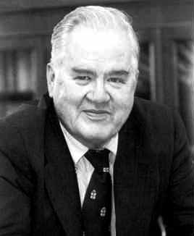
L01 - History of Software Engineering
Software is everywhere
  buying bread, driving car, washing clothes
  synonyms: programs, applications
People, who develop the software
  software engineers, software developers, programmers
  they possess skills and tools that allow them to develop and evolve software
John W. Tukey, 1915-2000
Statistician
Coined terms “software” in 1958; “bit”
© 2012 Václav Rajlich with addition from D. Hou Software Engineering: The Current Practice Ch. 1
Notes:
John Tukey, 85, Statistician; Coined the Word 'Software'
By DAVID LEONHARDT
Published: July 28, 2000
http://www.nytimes.com/2000/07/28/us/john-tukey-85-statistician-coined-the-word-software.html
Liu: Dr. Tukey is the inventor of FFT.

Slide 2








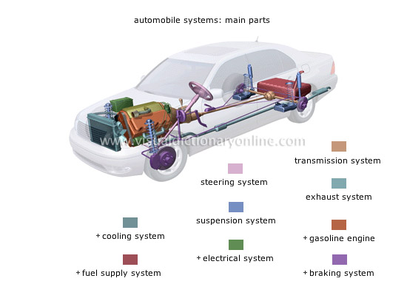





Notes:
Liu – Software is everywhere. Embedded system, financial system, online shopping, social network, …

Slide 3
Software engineering
Set of recommendations how to develop software
  “software” is a result of “software engineering”
A discipline with a considerable body of knowledge and considerable importance in both academia and industry

Slide 4

Beginning of software
Software separated from the hardware in 1950’s
  emerged as a distinct technology
  became independent product
Original programmers recruited from the ranks of electrical engineers and mathematicians
  used ad-hoc techniques from their former fields
  Developed compilers, operating systems, early business software
Watch trailer on Youtube
https://www.youtube.com/watch?v=S5CjKEFb-sM

Slide 5
Paradigm
Thomas S. Kuhn
  “The Structure of Scientific Revolutions”
Paradigm
  “Coherent tradition of scientific research”
    includes law, theory, application, instrumentation, terminology, research agenda, textbooks, norms, curricula, process, culture of the field …

Slide 6
Anomaly
“Anomaly is an important fact that directly contradicts the old paradigm”
Dilemma: disregard anomaly vs. paradigm shift
  to shift paradigm means to abandon large part of the investment
  the anomaly must be compelling

Slide 7

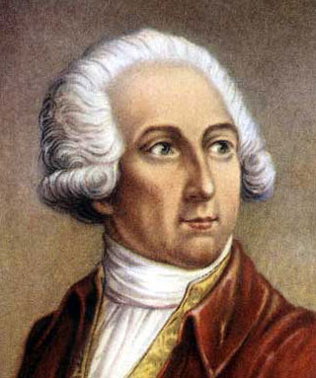
Paradigm shift
Discontinuity in the development of the discipline (revolution)
  Kuhn collected extensive historical data on paradigm shift
  phlogiston - > oxygen in 1770’s
    Antoine Lavoisier
Notes:
Antoine-Laurent de Lavoisier was a French nobleman and chemist central to the 18th-century chemical revolution and a large influence on both the history of chemistry and the history of biology.
Lavoisier is most noted for his discovery of the role oxygen plays in combustion. He recognized and named oxygen (1778) and hydrogen (1783) and opposed the phlogiston theory.

Slide 8
Resistance to paradigm shift
Advantages of the new paradigm is in dispute
  attempts are made to extend old paradigm to accommodate anomalies
  band-aid approaches try to fix old paradigm
Knowledge and investment accumulated up to that point may lose its significance
  some knowledge may be completely lost
Final victory of the new paradigm guaranteed by a generation change
Unsuccessful attempts at paradigm shift

Slide 9
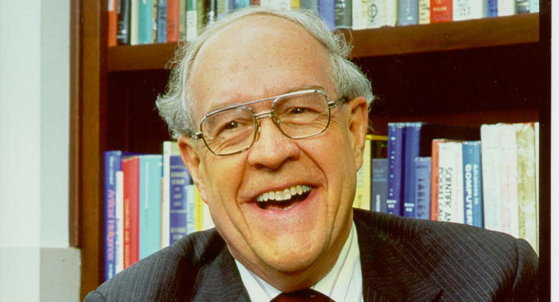

Paradigm shift of ~ 1970
Anomaly
  Previous techniques did not scale up
  Fred Brooks Jr.: “Mythical Man-Month”
  demands of the new operating system OS/360 taxed the limits of the programmers, project managers, and the resources of the IBM corporation
Paradigm shift established discipline of software engineering
  dealt with complexity of software
  software design established as an important consideration
  introduced the waterfall metaphor
Notes:
http://www.wired.com/2015/09/google-2-billion-lines-codeand-one-place/

Slide 10
Waterfall model
Requirements
Design
Implementation & Validation
transfer to the user
Maintenance
Notes:
Ann and Michael Norvak wants to build a house

Slide 11
Waterfall metaphor (linear process)
Used in construction and manufacturing
  collect the requirements
  create a design
  follow the design during the entire construction
  transfer finished product to the user
  solve residual problems through maintenance
Intuitively appealing metaphor
  good design avoids the expensive late rework
  waterfall became the dominant paradigm

Slide 12
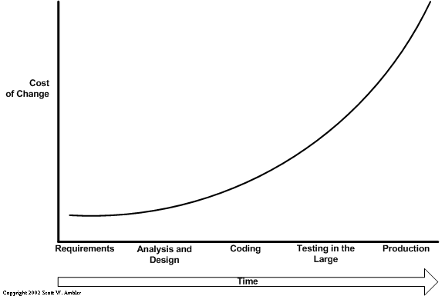
Exponential cost of change
major contributor to software cost

Slide 13
Waterfall paradigm
Elaborate up-front activities
  BDUF (Big Design Up Front)
Adopted by Department of Defense
  e.g., DOD-Std-2167A: Defense Systems Software Development)
Textbooks
  Still largely based on the waterfall

Slide 14
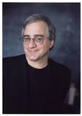
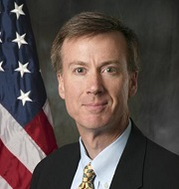
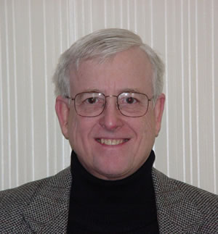
Anomaly: Requirements volatility
Cusumano and Selby 1997:
  30% or more requirements at Microsoft may change during development
  this is the direct result of the team’s learning process and software conformity
Capers Jones 1996:
  IT requirements change at a rate 2 – 3% per month
Notes:
Michael A. Cusumano is the Sloan Management Review Distinguished Professor at the MIT Sloan School of Management.
Dr. Richard W. Selby
Director of Engineering, Northrop Grumman Aerospace Systems
Capers Jones is an American specialist in software engineering methodologies, and is often associated with the function point model of cost estimation.

Slide 15
Standish group anomaly
In 1995
  31% of all software projects were cancelled
  53% were “challenged” (completed only with great difficulty, with large cost or time overruns, or substantially reduced functionality)
  only 16% could be called successful
Obviously, the waterfall metaphor did not solve the problems of software development

Slide 16
Band-Aid: Anticipation of changes
If changes can be anticipated at design time, they can be controlled by a parameterization, encapsulations, etc.
  waterfall model still can be used
Experience confirms:
  many changes are not anticipated by the original designers
  inability to change software quickly and reliably means that business opportunities are lost
  only a band-aid solution

Slide 17
Band-Aid: Prototyping
Create a prototype to capture requirements
Problem: volatility continues after prototype has been completed
Another band-aid

Slide 18
Paradigm shift of ~ 2000
New life span models emphasize software evolution
  staged model of software lifespan
  based on data from long-lived systems
Iterative development
  Rational Unified Process
Agile development
  SCRUM
  Extreme programming

Slide 19
Summary of paradigms
The waterfall paradigm tried to freeze requirements for the duration of software development
  led to too many project failures
  Still used by ~18% projects according to recent survey
The new paradigm emphasizes software evolution
  interoperability and complexity cause volatility
    volatility is a consequence of essential properties

Slide 20
All three paradigms currently coexist
Ad hoc paradigm still used by some single programmers
    programming as an art rather than engineering
    example: small games
Waterfall works if there is no volatility
    small or short-lived projects
    unusually stable requirements and environments
    some managers still insist on it
Evolutionary paradigm is the mainstream

Slide 21
Difficulties that programmers face
Accidental difficulties
  difficulties of current/ past/ future technologies
  quirks of the operating systems, compilers, languages, processes
  they come and go
Essential difficulties of software
  subset of essential (defining) properties
  no easy answers to essential difficulties !!!

Slide 22
Essential difficulties
Invisibility
    senses cannot be easily used in comprehension
    visualizations, sonifications, require lots of work
Complexity
    programs are among most complex systems ever created
    our short-term memory accommodates only ~7 things
Changeability
    software is constantly changing
    yesterday’s comprehension may be obsolete

Slide 23
Essential difficulties, cont.
Conformity
  Large system (hardware, users, domain)
  The program glues it all together, reflects the large system
  This adds even more complexity
Discontinuity
  People easily understand linear or semi-linear
  Software is discontinuous, small change of input can result in huge change of output: password

